Slide 1
Web Architecture
Week 01.

Slide 2
Objectives
Describe the structure of a web application and its life cycle;
Describe the objectives, characteristics and functions of a 3-tier web architecture;
Demonstrate an awareness of trends in web development technologies;
Describe how web protocols work.

Slide 3
What is a Web Application?
It is a software program that
runs on a web server
uses HTTP (Hypertext Transfer Protocol) for its core communication protocol
delivers information to the user in the HTML language
is accessed from a web browser (client)
accessed by many clients at the same time
In this subject, we will learn how to develop web applications using:
HTML5
CSS3
JavaScript
Node.js
SQL

Slide 4
Web Architecture
Compared with non-web applications, more resources are required to support running web applications.
The required resources together is known as Web Architecture.

Slide 5
Stand-Alone Application
Need just a PC / laptop to work
No communication to any server, i.e. no need for computer to be connected to a network
Examples:
Microsoft Word
Notepad
Microsoft Excel
Adobe Photoshop

Slide 6
Client-Server Application
The application needs to communicate with a server to work
E.g. Skype, Outlook
Web browsers
Client – the program running on the user’s PC i.e. the one that you “run”
e.g. browser, Skype
Server – the machine that the client get contents from
The server is usually not obvious to the user
e.g. web server, messaging server, email server

Slide 7
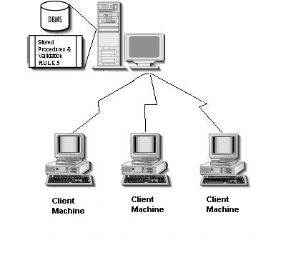
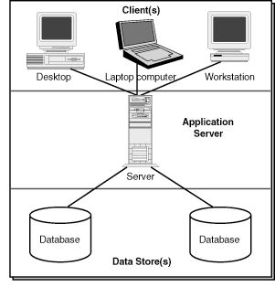
Client-Server Model
1 server, many clients
Examples:
1 Mail server, many Mail Clients such as Outlook, Gmail, Yahoo Mail
1 Skype server, many Skype Clients
1 Website, many browsers

Slide 8
3-Tier Web Architecture
A web application usually need a database to store information
Client-Server-Database
3-tier architecture
For this semester, we will use:
Client: Google Chrome Browser
Web Server: Node.js
Database: MySQL Server

Slide 9
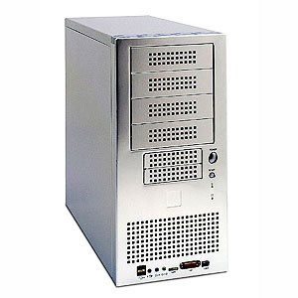
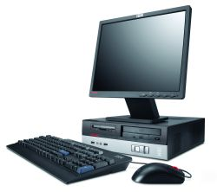










3-Tier Web Architecture
Web Browser on
Client Device
Web Application
on Web Server
Database on
Database Server

Slide 10
3-Tier Web Architecture
Web Browser on Client Device
Input / Output:
User Interface (Page layout / look and feel)
Web Application on Web Server
Information Processing:
Application Logic
Database on Database Server
Data Access:
Information Storage
Data Entry
Data Validation
Output Formatting
Computational Processing
Information Retrieval
Database Maintenance
Using HTML, CSS, JavaScript
Using JavaScript
Using SQL

Slide 11
3-Tier Web Architecture
The client (browser), server and database can be located separately in any part of the world
They will work as long as the network connection is up
For performance reasons, the web server and database server are usually located very close to each other
Where does the web application run on?
browser / server / database?

Slide 12
Benefits of 3-Tier Architecture
Well-defined development goals for each tier
Can divide and assign different tier to different development team
Encapsulation/Hiding of functionalities
Easier to modify or replace any tier without affecting other tiers
Better load balancing can be achieved
Web/Application server and database server can be running on different machines

Slide 13
Web Application
A web application (web forms and C# code) runs on the web server, but the user accesses the web application through the client (browser).
The browser is also known as the front-end or the client.
It displays the web pages and prompts user for input.
The web server is also known as the backend.
It hosts websites, runs the web application.
It serves the front-end clients by fulfilling their requests.
The browser talks to the server using Hypertext Transfer Protocol (HTTP).

Slide 14
Communication Between Client & Server
Browser sends request
Server responds with webpage/data
Browser
(client)
server
Uses an industry standard protocol - HTTP
HTTP stands for Hypertext Transfer Protocol
The HTTP protocol is a request-response protocol
The browser starts the communication by making a request
The server responds by sending the client a resource e.g. webpage, image etc.

Slide 15
Browser Request
Browser starts by requesting for a HTML page using a URL
e.g. http://lms.tp.ed.sg
Browser sends the HTTP request to web server using either of the following four HTTP methods
GET
POST
PUT
DELETE

Slide 16
Server Side Processing
Web server receives the request and looks at the URL
If the URL is for a static webpage/image:
The webpage/image is sent immediately to the browser
If the URL is for a web functionality:
The web functionality is executed
The output of the program/function execution is sent to the browser

Slide 17
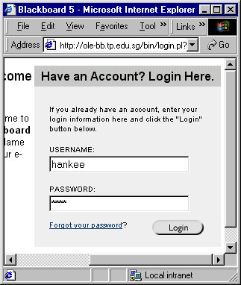
Server Response (Login Scenario)
2. The requested HTML page or output from web application is sent from the server to the client as a HTTP Response
3. Browser displays login page to the user
4. User types in username and password
5. User clicks on login button
1. User access web page via URL

Slide 18


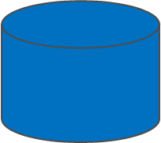
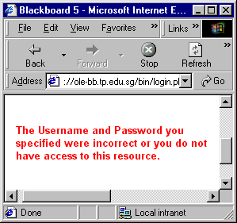
Request-Response (Login Scenario)
1. Request (send login credential)
2. Processing
Database Server
Web application
(Web Server)
3. Response

Slide 19
Uniform Resource Locator (URL)
All resources on a website including your webpages, images, stylesheets etc are accessed by specifying their URL(Uniform Resource Locator)
The URL is shown in the Address field of the browser
URL format: protocol://hostname[:port]/url-path/resource
e.g.
http://www.tp.edu.sg:8080/home/life/stu_cca.htm
The host name “localhost” means the server is on the same machine as the browser. The IP address will be 127.0.0.1.
Port number is optional. Default is port 80.

Slide 20
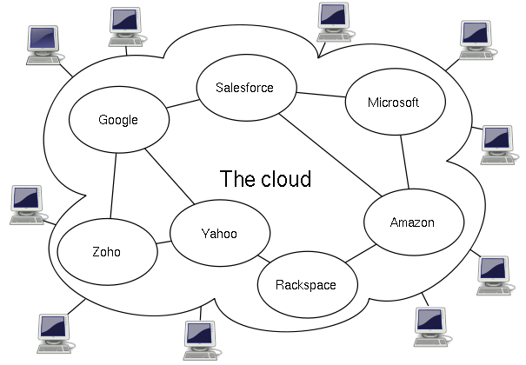
Cloud Computing
Internet based computing
Shared resources are made available to devices on demand like a public utility
Technology infrastructure are abstracted from users
Typical cloud computing provides common business applications which are accessed from a web service or web browser while software and data are stored in servers.
Why cloud computing?
Users can avoid capital expenditure on hardware, software;
Costs are based on utility or subscription basis with little or no upfront costs;
Immediate access to wide range of services.

Slide 21
THE END

